Slide 1
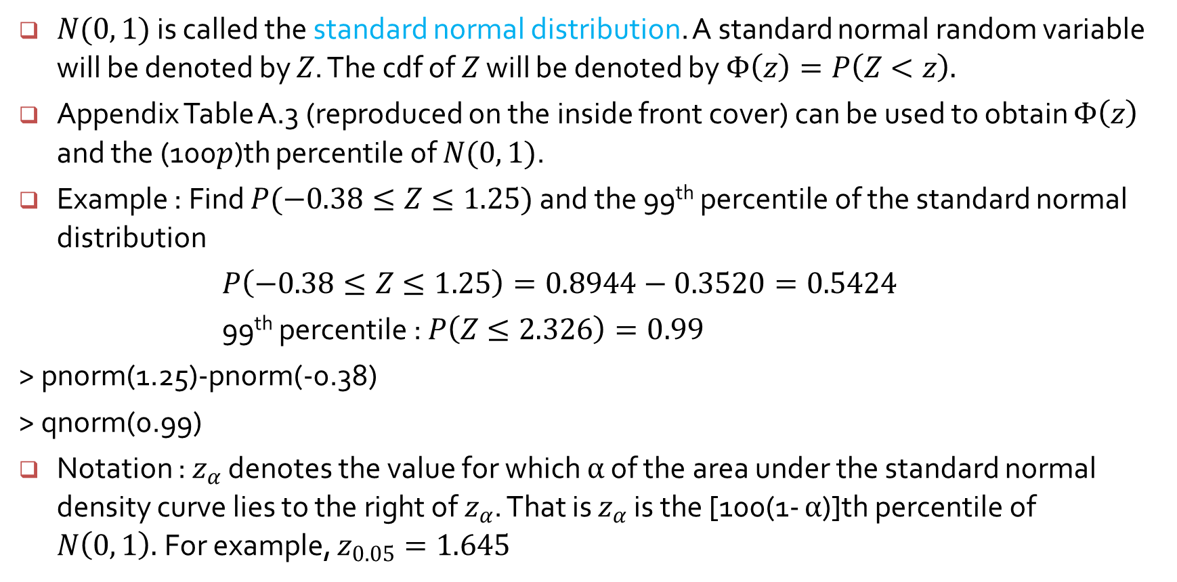
The standard normal distribution
$N(0, 1)$ is called the standard normal distribution. A standard normal random variable will be denoted by $Z$. The cdf of $Z$ will be denoted by $Φ\left(z\right)=P\left(Z<z\right).$
Appendix Table A.3 (reproduced on the inside front cover) can be used to obtain $Φ\left(z\right)$ and the (100$p$)th percentile of $N(0, 1)$.
Example : Find $P(−0.38≤Z≤1.25)$ and the 99th percentile of the standard normal distribution
$P\left(−0.38≤Z≤1.25\right)=0.8944−0.3520=0.5424$
99th percentile : $P\left(Z≤2.326\right)=0.99$
> pnorm(1.25)-pnorm(-0.38)
> qnorm(0.99)
Notation : $z_{α}$ denotes the value for which $α$ of the area under the standard normal density curve lies to the right of $z_{α}$. That is $z_{α}$ is the [100(1- $α$)]th percentile of $N\left(0, 1\right).$For example, $z_{0.05}=1.645$

Slide 2
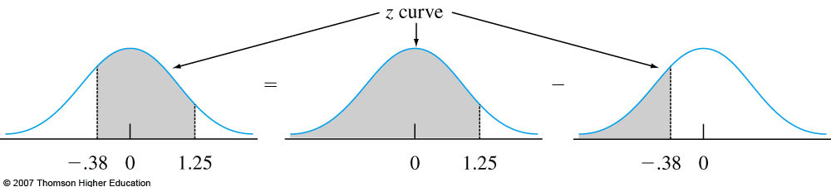
0.8944
0.3520
Fig. 4-16, p. 147
Notes:
Figure 4.16
P(−.38 ≤ Z ≤ 1.25) as the difference between two cumulative areas.

Slide 3
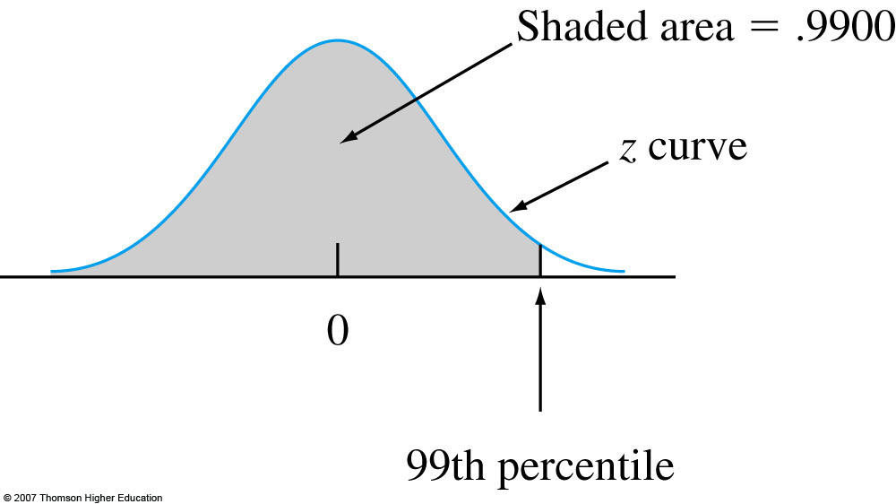
Fig. 4-17, p. 147
Notes:
Figure 4.17
Finding the 99th percentile.

Slide 4
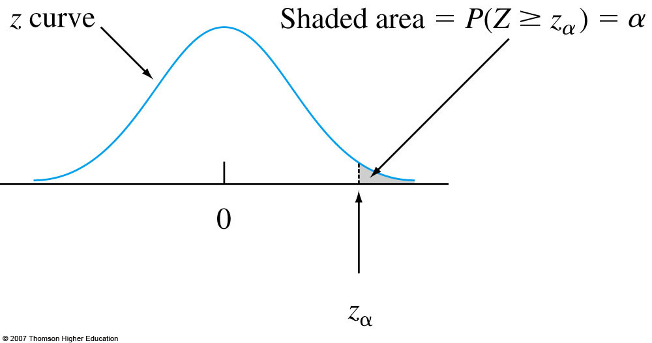
Fig. 4-19, p. 148
Notes:
Figure 4.19
z_{α} notation Illustrated.

Slide 5
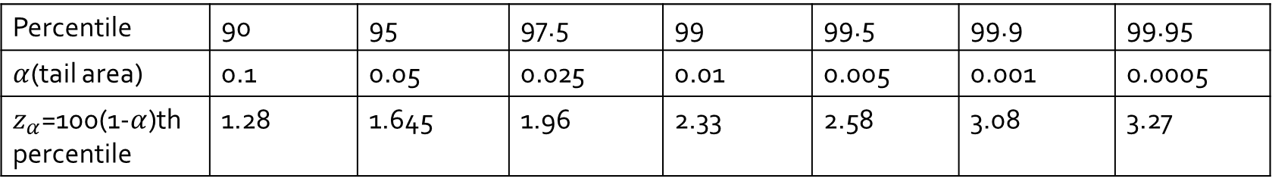
The standard normal distribution
Table 4.1 Standard Normal Percentiles and Critical Values
Percentile | 90 | 95 | 97.5 | 99 | 99.5 | 99.9 | 99.95
$α$(tail area) | 0.1 | 0.05 | 0.025 | 0.01 | 0.005 | 0.001 | 0.0005
$z_{α}$=100(1-$α$)th percentile | 1.28 | 1.645 | 1.96 | 2.33 | 2.58 | 3.08 | 3.27

Slide 6
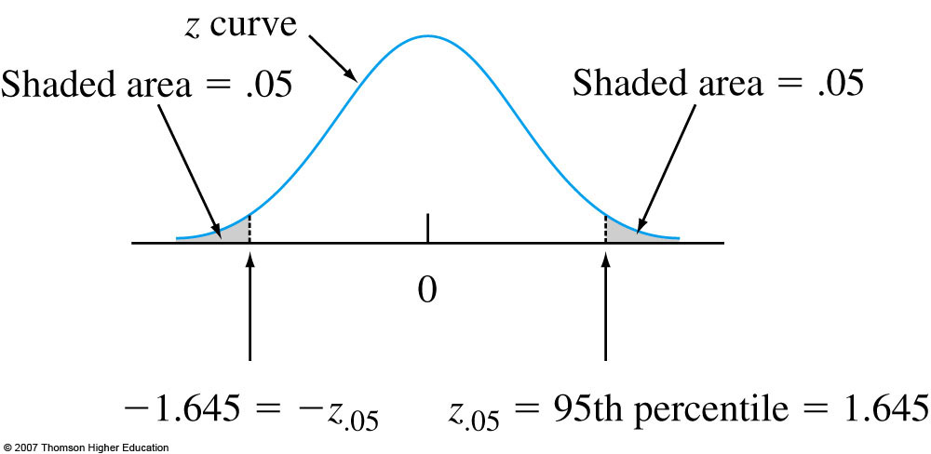
Fig. 4-20, p. 149
Notes:
Figure 4.20
Finding z_{.05}.

Slide 7
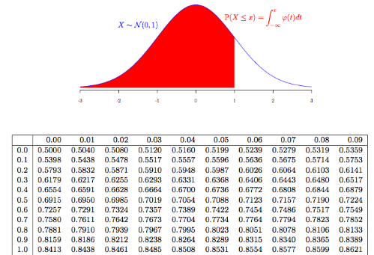
Normal Distribution Table

Slide 8
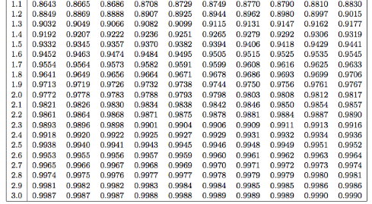

Slide 9
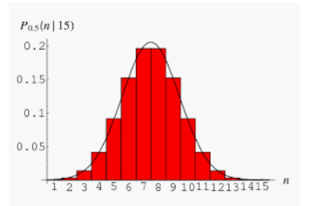
Numerical integration of Normal distribution $\int_{−1}^{1}{f\left(x\right)dx}$
# divide (-1, 1) into 10000 subintervals and sum the area of the 10000 rectangles
x <- seq(-1, 1, length=10000)
sum((1/sqrt(2*pi)*exp(-x^2/2))*1/5000)

Slide 10
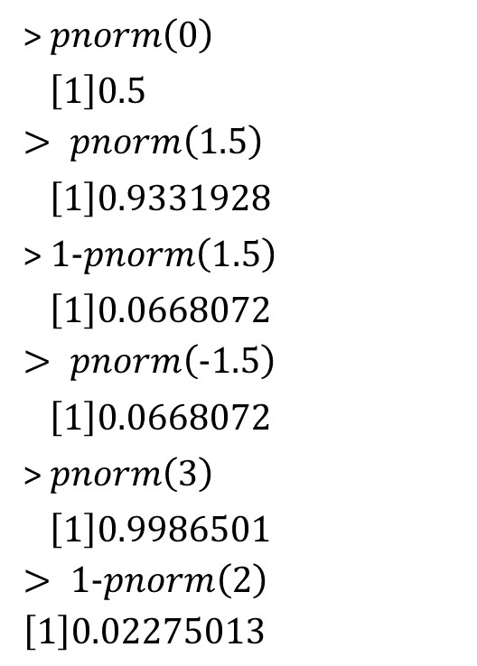

Find
$P(Z≤0)$
$P(Z<1.5)$
$P(Z≥1.5)$
$P(Z<−1.5)$
$P(Z≤3)$
$P(Z>2)$
> $pnorm\left(0\right)$
$\left[1\right]0.5$
$$> pnorm\left(1.5\right)$$
$\left[1\right]0.9331928$
> $1−pnorm\left(1.5\right)$
$\left[1\right]0.0668072$
$$> pnorm\left(−1.5\right)$$
$\left[1\right]0.0668072$
> $pnorm\left(3\right)$
$\left[1\right]0.9986501$
$$> 1−pnorm\left(2\right)$$
$$\left[1\right]0.02275013$$

Slide 11
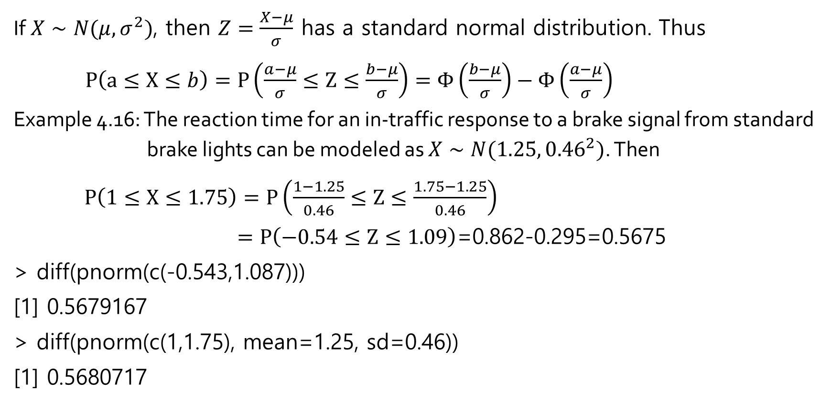
Nonstandard normal distribution
If$X∼N(μ, σ^{2})$, then $Z=\frac{X−μ}{σ}$ has a standard normal distribution. Thus
$P\left(a≤X≤b\right)=P\left(\frac{a−μ}{σ}≤Z≤\frac{b−μ}{σ}\right)=Φ\left(\frac{b−μ}{σ}\right)−Φ\left(\frac{a−μ}{σ}\right)$
Example 4.16: The reaction time for an in-traffic response to a brake signal from standard brake lights can be modeled as $X∼N(1.25, {0.46}^{2})$. Then
$P\left(1≤X≤1.75\right)=P\left(\frac{1−1.25}{0.46}≤Z≤\frac{1.75−1.25}{0.46}\right)$
$=P\left(−0.54≤Z≤1.09\right)$=0.862-0.295=0.5675
> diff(pnorm(c(-0.543,1.087)))
[1] 0.5679167
> diff(pnorm(c(1,1.75), mean=1.25, sd=0.46))
[1] 0.5680717

Slide 12
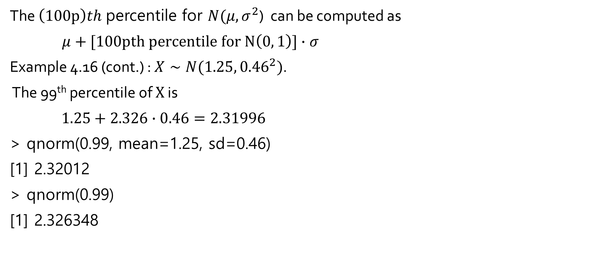
Percentiles of normal distribution
The $\left(100p\right)th$percentile for $N(μ, σ^{2}$) can be computed as
$μ+[100pth percentile for N\left(0, 1\right)]∙σ$
Example 4.16 (cont.) : $X∼N(1.25, {0.46}^{2})$.
The 99th percentile of $X$ is
$1.25+2.326∙0.46=2.31996$
> qnorm(0.99, mean=1.25, sd=0.46)
[1] 2.32012
> qnorm(0.99)
[1] 2.326348

